Slide 1

Connected Campus
Mark Girguis, Kishan Patel, Ankit Monga,
Eric Gonzalez, Jason Chung, Hector Khuon

Slide 2
The Team | Roles
Mark Girguis - Project Manager
Kishan Patel - Programmer
Ankit Monga - Data Analyst
Eric Gonzales - Business Analyst
Jason Chung - Systems Designer
Hector Khuon - Quality Assurance

Slide 3
Deliverable 4

Slide 4
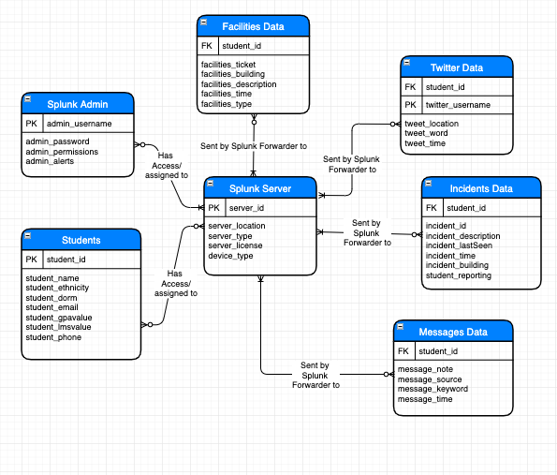
ERD

Slide 5
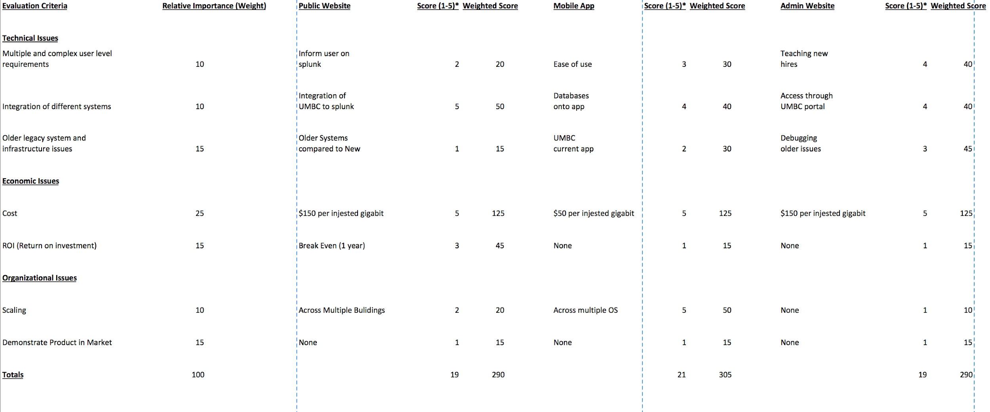
Alternative Matrix

Slide 6
Normal Matrices

Slide 7
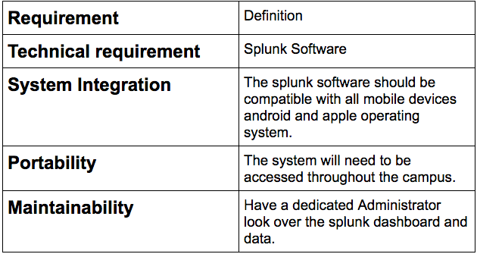
Matrix 1: Operational Requirements

Slide 8
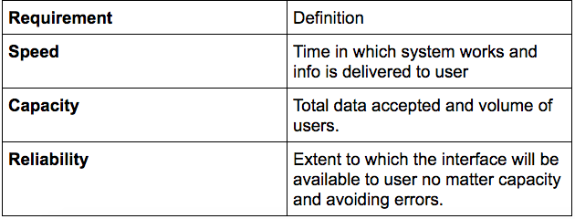
Matrix 2: Performance Requirements

Slide 9
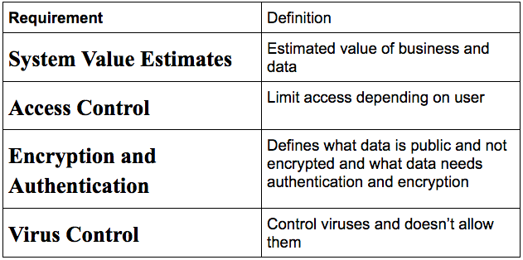
Matrix 3: Security Requirements

Slide 10
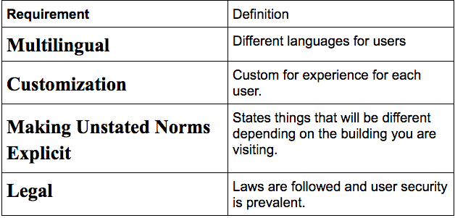
Matrix 4: Cultural/Political Requirements

Slide 11
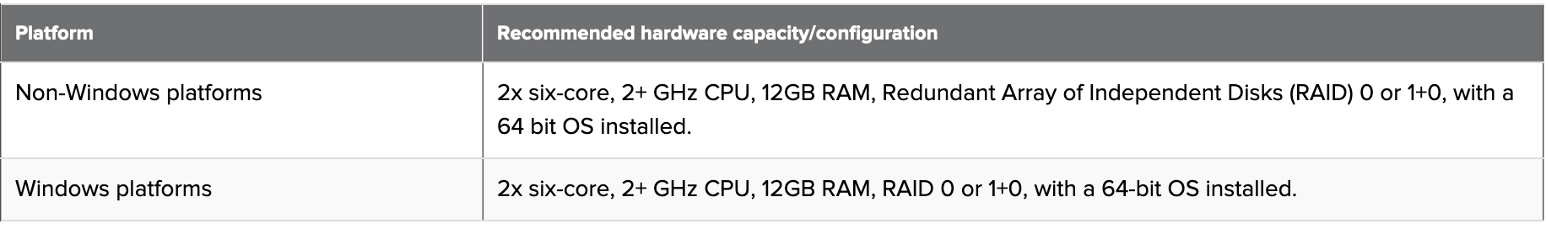
Hardware and Software Specifications
Software requirements
A version of CentOS or RedHat Enterprise Linux (RHEL), Windows OS, Mac OS
Splunk Enterprise 7.0 or later.
Web Browser
Chrome
FireFox
Explorer
Hardware requirement
4 cores - 4 vCPUs or 2 vCPUs with 2 cores with a reservation of 2 GHz
6GB memory with a reservation of 1 GB
4-10 GB of disk space
m Splunk requirement for the Splunk App for NetApp Data ONTAP. You cannot use a universal forwarder.

Slide 12
Project Plan

Slide 13
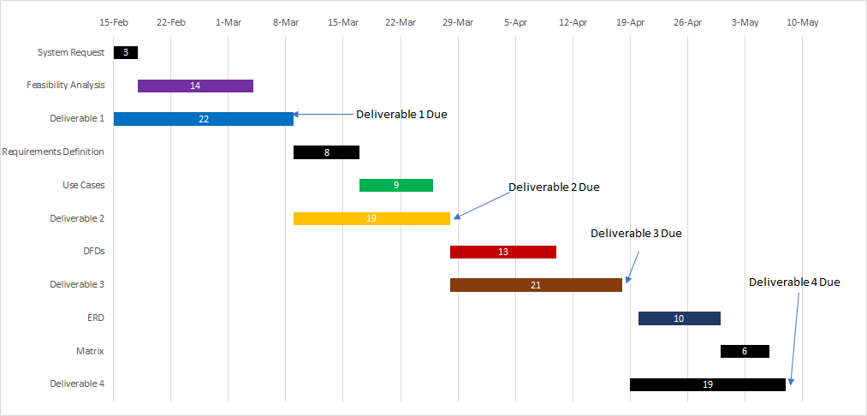

Slide 14
Deliverable 5

Slide 15
Principles for User Interface Design
Layout
The navigation area and work area are divided into separate boxes
Like areas: Student Success, etc. are grouped for navigation
The work area comprises of user specific information
Layout is consistent and balanced across all pages for easy navigation
Content Awareness
Every interface is clearly titled
Menus show what area of site the user is in
Dropdown menus give more specific context
Aesthetics
Content is evenly spaced
Font and size is designed for easy readability
Consistency
Elements such as navigation bar are consistent throughout the site

Slide 16
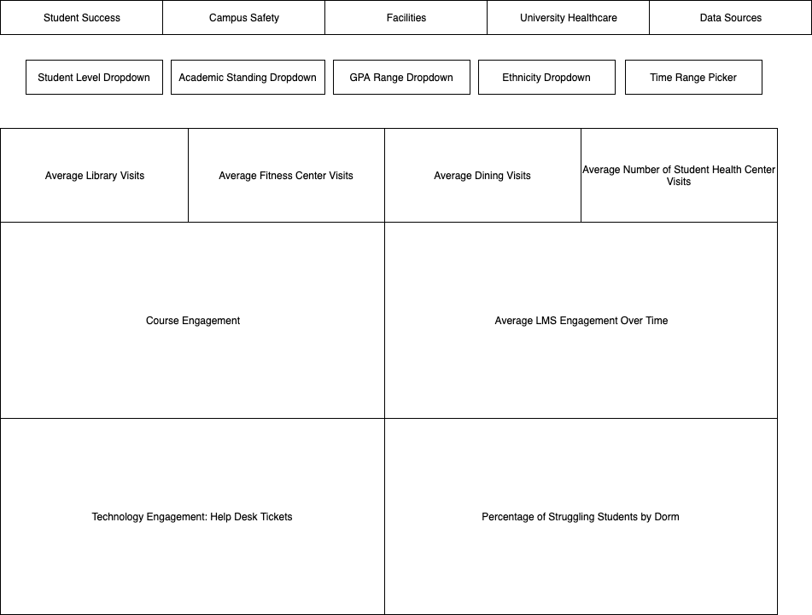
Student
Standard
Dashboard

Slide 17
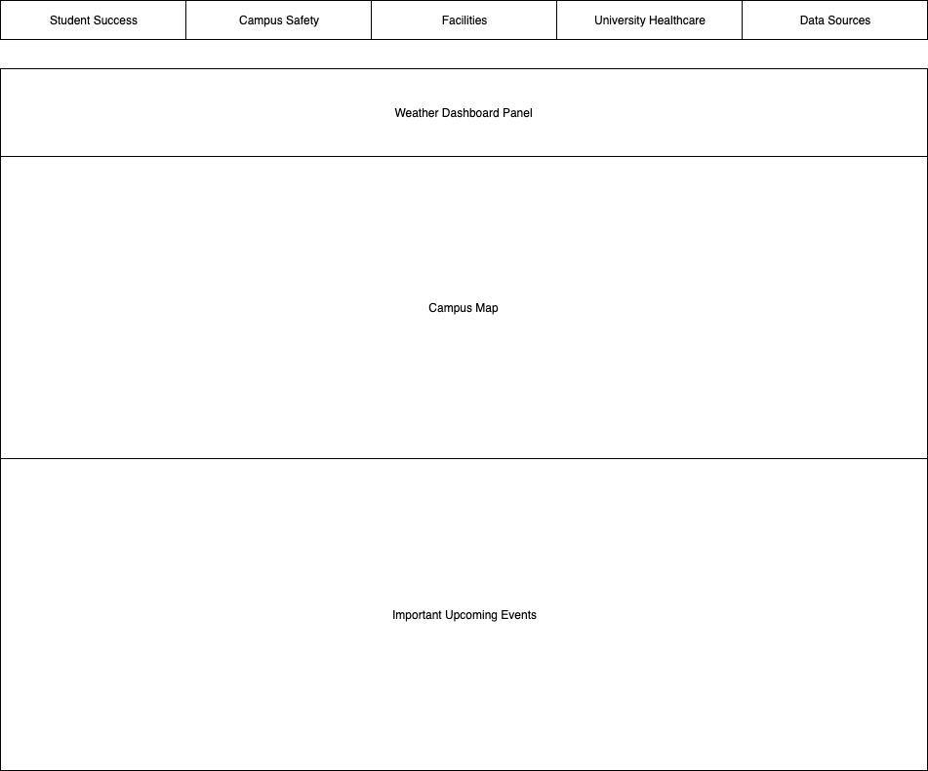
Facilities
Dashboard

Slide 18
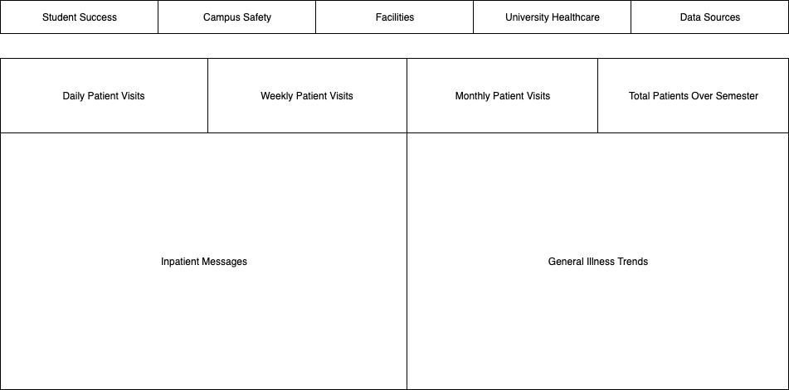
Student Health Center

Slide 19
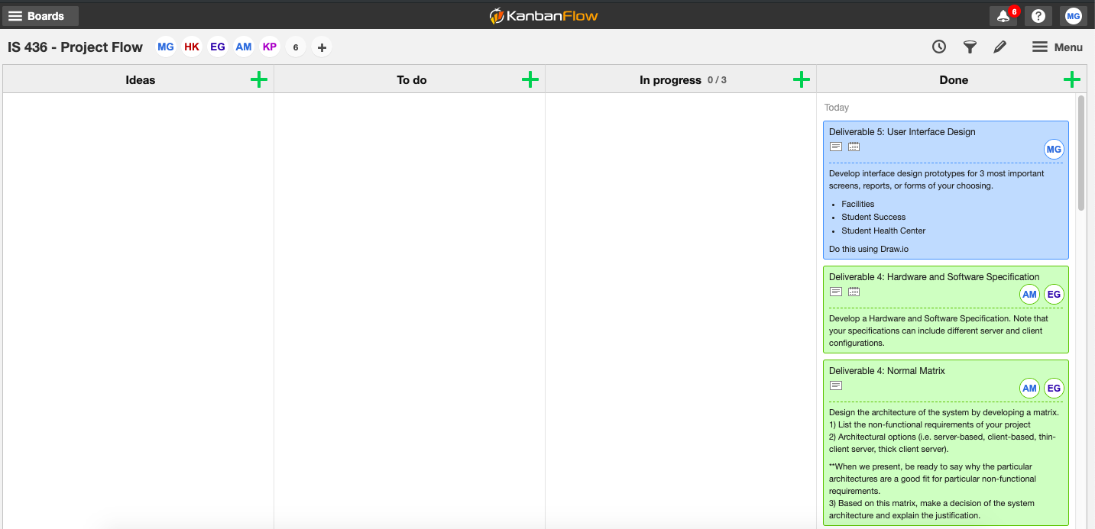
Kanban Flow

